Slide 1

Helping You Reach Out to Your Book Loving Customers Better
PROJECT - 01

Slide 2

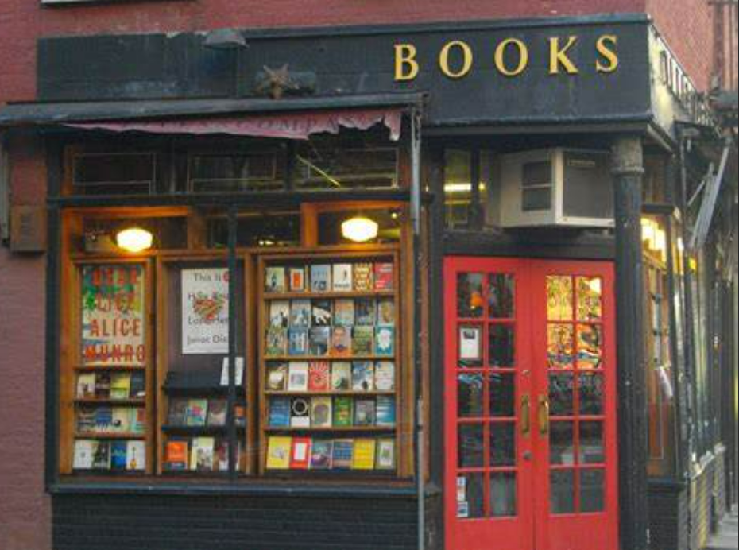
Group Members
Norma Espinosa
Laleh Safarzadeh
Kristen Wilder
Angele Yazbec

Slide 3

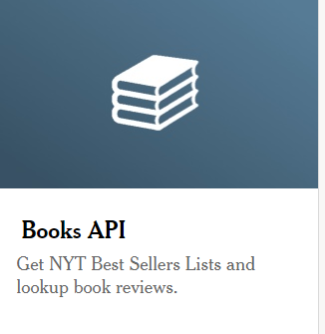
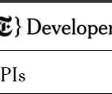
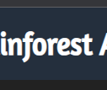
Data to be used:
New York Times Books API
- Obtain bestsellers
Rainforest API—Amazon Product API

Slide 4

Task Outline
Task 1: Mine data from New York Times Book API, clean data, create csv
Task 2: Mine data from Rainforest API, clean data, add to csv
Task 3: Exploratory data analysis
Task 4: Visualizations
Presentation/PowerPoint
Write-Up Summarizing Finding

Slide 5
Task Division
Laleh—New York Times API data mining, cleaning using Pandas, create CSV file, help with summary and PPT
Angele—Rainforest API data mining, cleaning using Pandas, merge with prior CSV file and clean, write-up summarizing major findings, assist with PPT
Norma—For some of the research questions: conduct exploratory data analyses with Pandas, data visualizations (Pandas and/or matplotlib), assemble PowerPoint and add visuals
Kristen— For some of the research questions: conduct exploratory data analyses with Pandas, data visualizations (Pandas and/or matplotlib), assist with PowerPoint and add visuals, assist with summary

Slide 6
Research Questions
Research Question 1: What are the top ten rated books and their authors?
Research Question 2: What is the average price for each book category?
Research Question 3: What is the average number of ratings for each book category?
Research Question 4: Who are the top 10 authors with the most best-selling books in all categories
Research Question 5: Which books are the top ten most popular overall?
Research Question 6: What are the Amazon ratings for the books ranked #1 on the NYT Bestseller list?
Research Question 7: Which books were rated most highly: printed or e-books on Amazon? Fiction or nonfiction?
Research Question 8 Which type of book is more popular on Amazon: printed books or e-books?

Slide 7
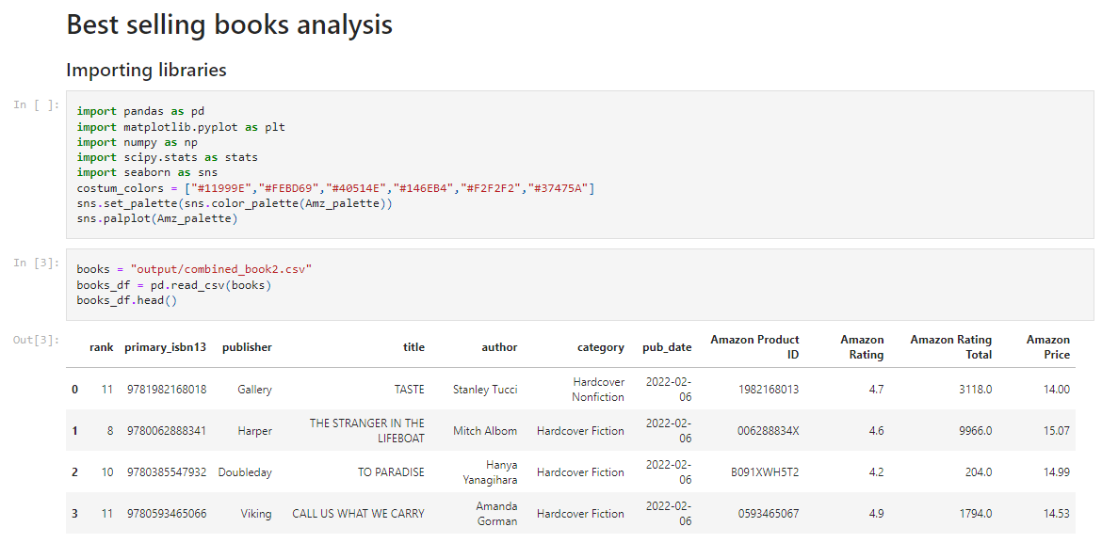

Slide 8
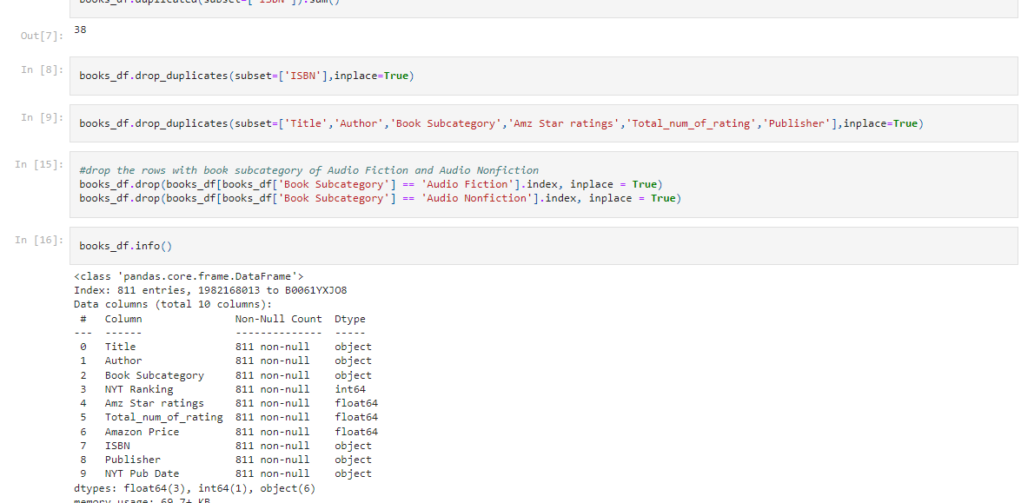

Slide 9
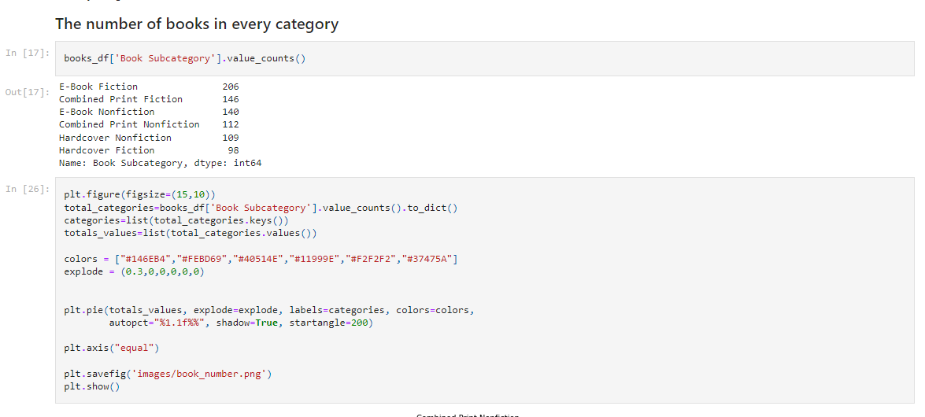

Slide 10


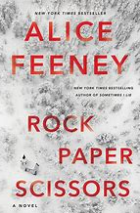


What are the top ten rated books and their authors?
The top ten books rated books on Amazon (having ratings of 4.9 or 5) are:
“The Quiet” by Susan Cain
“The Bomber Mafia” by Malcolm Gladwell
“Project Hail Mary” by Andy Weir
“Rock Paper Scissors” by Alice Feeney
“Red-Handed” by Peter Schweizer
“American Marxism” by Mark R. Levin
“A Dog’s Purpose” by W Bruce Cameron
“Sum It Up” by Pat Head Summitt with Sally Jenkins
“Immune” by Philipp Dettmer
“This Bright Future” by Bob Hall

Slide 11
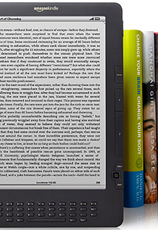

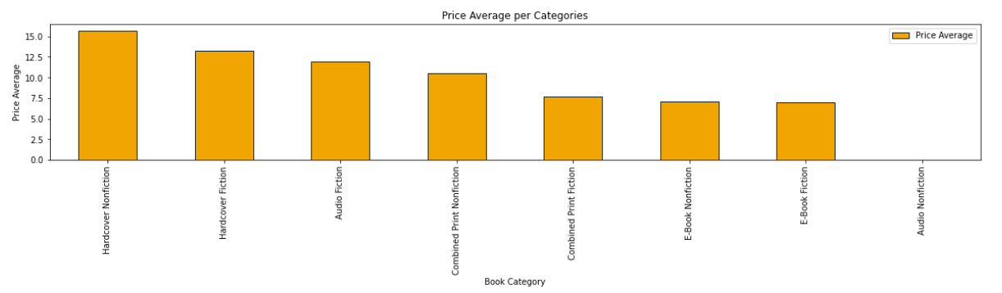
What is the average price for each book category?

Slide 12
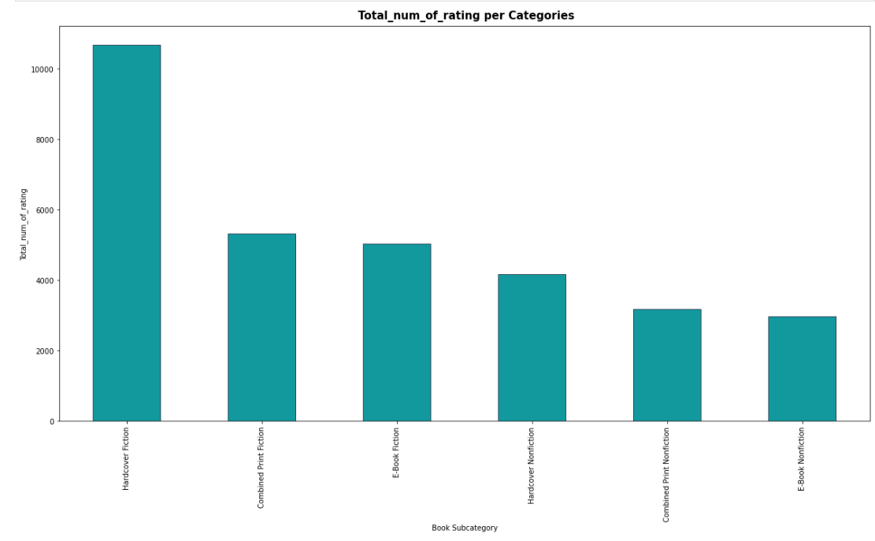


What is the average number of ratings for each book category?

Slide 13

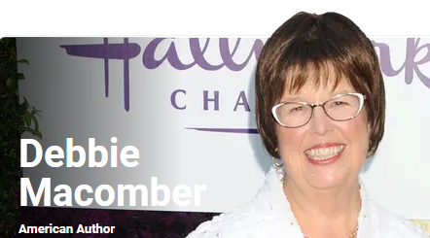
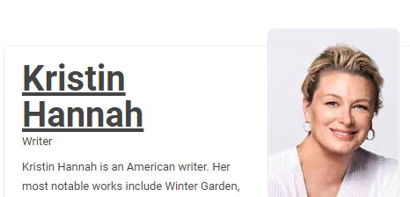

Who are the top 10 authors with the most best-selling books in all categories?
Danielle Steel
Debbie Macomber
David Baldacci
Kristin Hannah
Nora Roberts
James Patterson
John Grisham
Nicholas Sparks
Patricia Cromwell

Slide 14
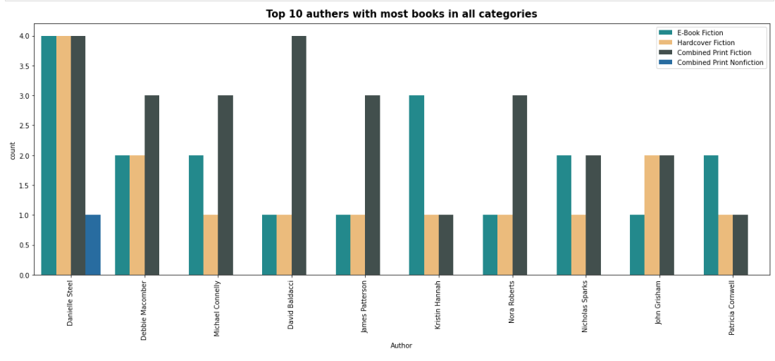

Slide 15
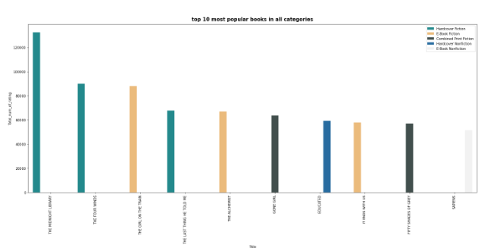




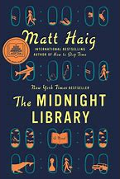
Which books are the top ten most popular overall?
“The Midnight LIbrary” by Matthew Haig
“The Four Winds” by Kristin Hannah
“The Girl on the Train” by Paula Hawkins
“The Last Thing He Told Me” by Laura Dave
“The Alchemist” by Paulo Coelho
“Gone Girl” by Gillian Flynn
“Educated” by Tara Westover
“It Ends WIth Use” by Colleen Hoover
“Fifty Shades of Gray” by E L James
“Sapiens” by Yuval Norah Harari

Slide 16
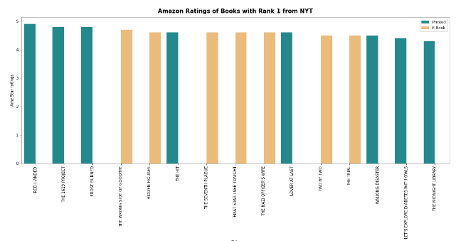
What are the Amazon ratings for the books ranked #1 on the NYT Bestseller list?

Slide 17
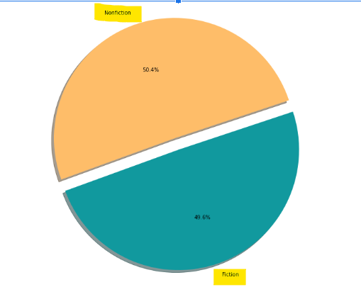
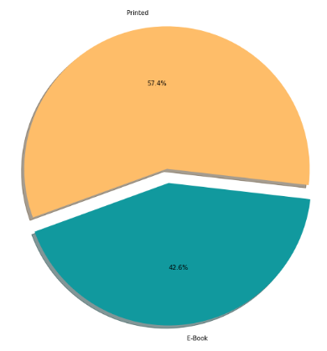
Which books were rated most highly: printed or e-books on Amazon? Fiction or nonfiction? NON-FICTION Which books were rated most highly: printed or e-books on Amazon? Fiction or nonfiction? PRINTED

Slide 18
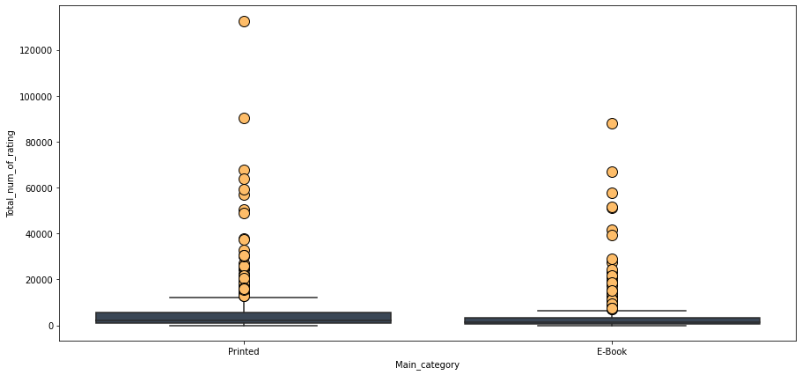
Which type of book is more popular on Amazon: printed books or e-books?

Slide 19
THANK YOU!

Slide 21

